Slide 1
P300 SPELLER
Harshita Priyadarshi, Apoorva Kumar, Prerna Mohan

Slide 2
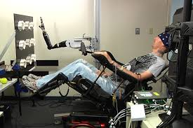
Brain Computer Interface
Brain computer interface (BCI), also known as brain machine interface (BMI), is a system that enables humans to interact with their surroundings via employing control signals generated from electroencephalographic (EEG) activity, without the intervention of peripheral nerves and muscles.
One of the most exciting areas of BCI research is the development of devices that can be controlled only through brain signals. These researches aim to use this technological breakthrough to help severely disabled people to function independently.
BCI is directed to robotics industry as the best solution to come up with a robot that senses and acts like human. Also currently scientists study the ways a human user can get a feedback on what the robot hand is experiencing; for example catching a ball or touching hot objects.

Slide 3
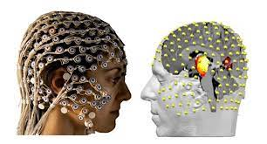
EEG (ELECTROENCEPHALOGRAPHY)
Brain neurons communicate with each other by producing tiny electrical signals, called impulses. These impulses can be measured using the EEG test. Electrodes, or sensors, are placed on the patient’s scalp to capture brain electrical signals in a form of polygraph.
Although EEG signals are used to diagnose brain diseases, such as Alzheimer’s disease, epilepsy disease, they also suitable tests for evaluating sleeping, learning, and attentional disorders, moreover monitor the brain responses during brain surgery.
Emotion recognition has emerged as a promising research topic since it provides a window on the user’s internal mental state.

Slide 4
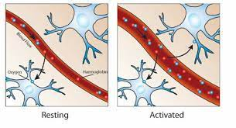
FMRI
Functional magnetic resonance imaging, or fMRI, is a relatively new procedure that uses magnetic resonance imaging (MRI) to establishing an activation map as indication for brain activity.
The MRI signal depends on the degree of oxygenation That blood oxygenation varies according to the levels of neural activity these differences can be used to detect brain activity.

Slide 5
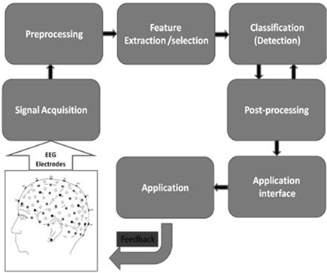
Control Signals in BCI Systems
BCI is an artificial intelligence based system that can recognize a certain set of patterns in brain EEG signals via a number of consecutive phases;

Slide 6
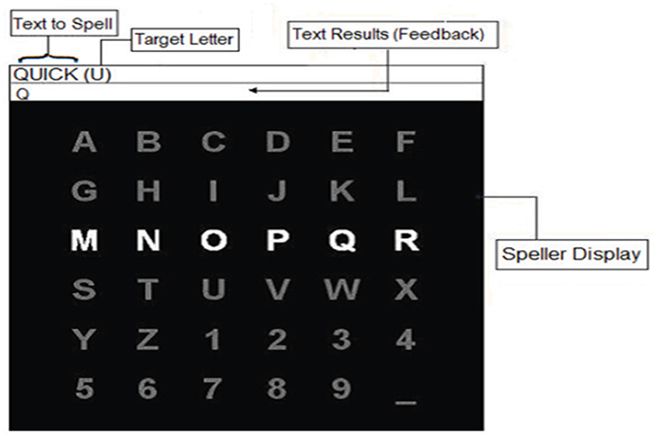
P300 SPELLER
The P300 speller is a type of brain writer that types characters using a P300 component derived from characters that flash randomly in a letter matrix (Farwell and Donchin, 1988).
A visual paradigm based P300 speller system consists of several stages: stimulating a subject by presenting a P300 display paradigm matrix; recording the EEG; signal preprocessing; feature extraction and classification.

Slide 7
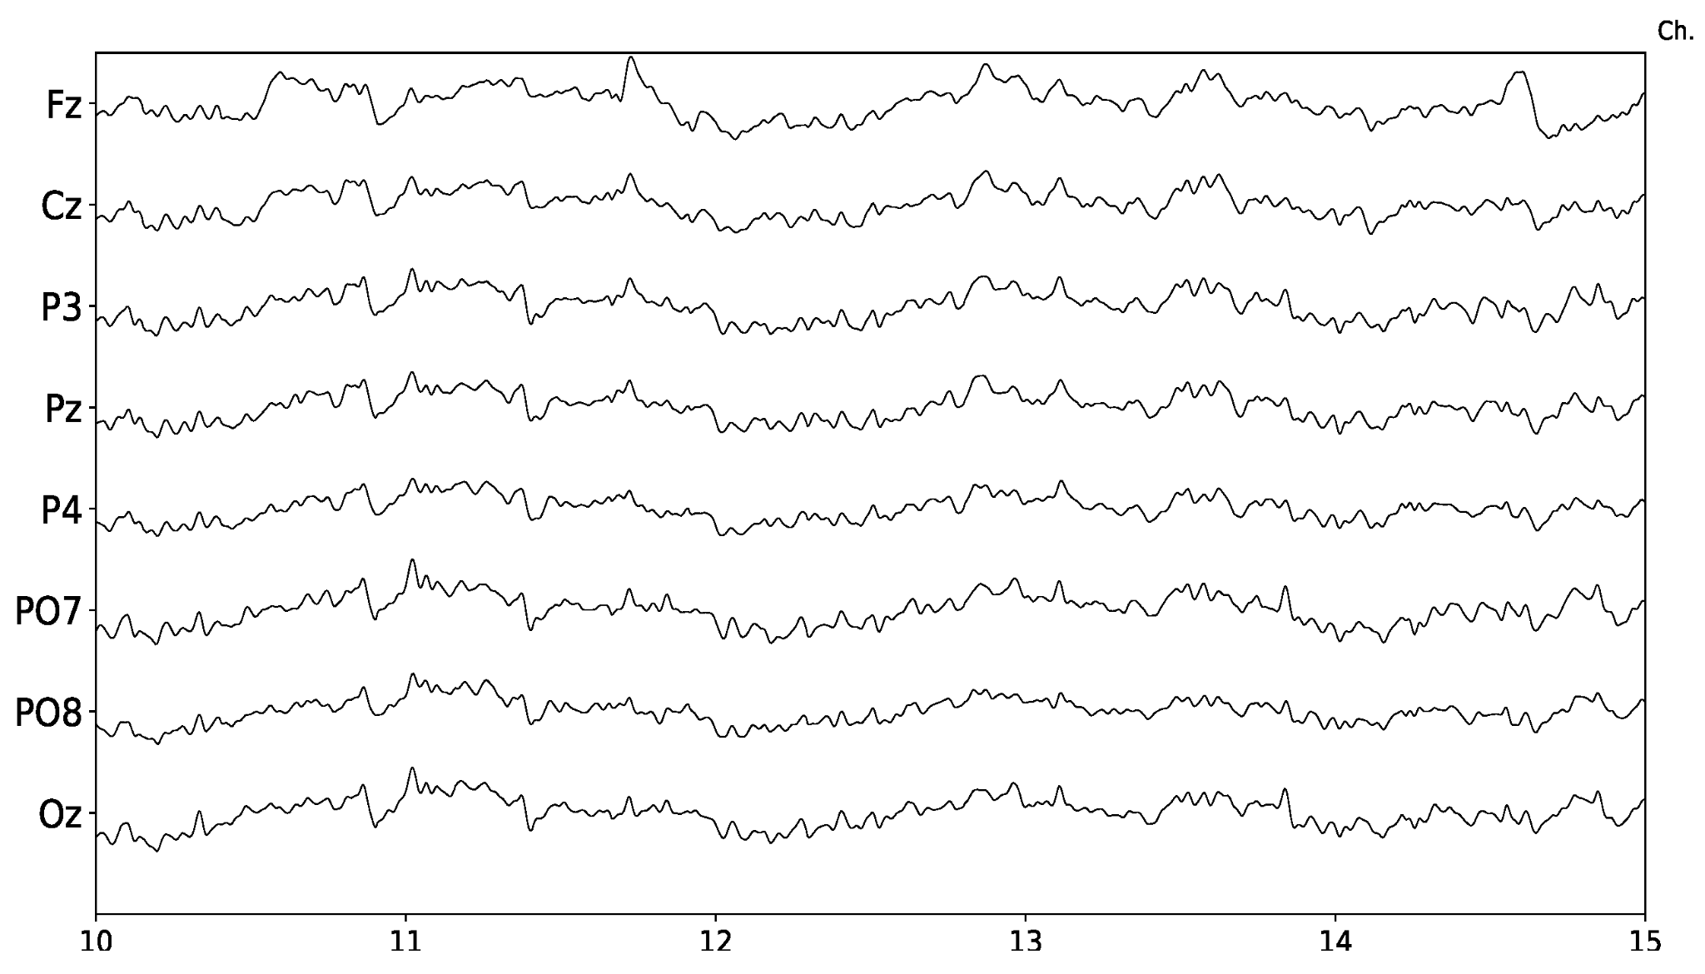
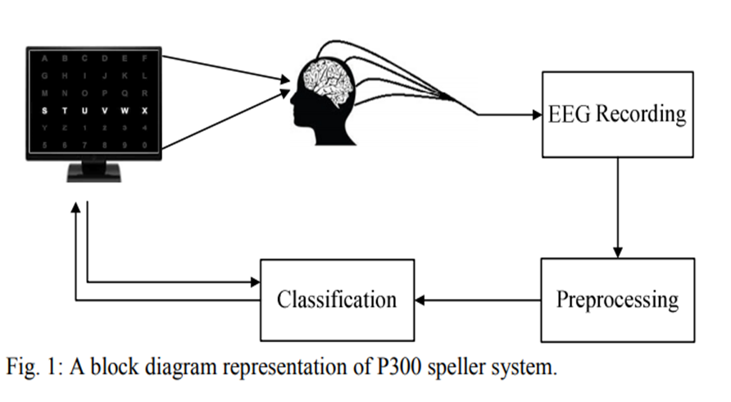

Slide 8
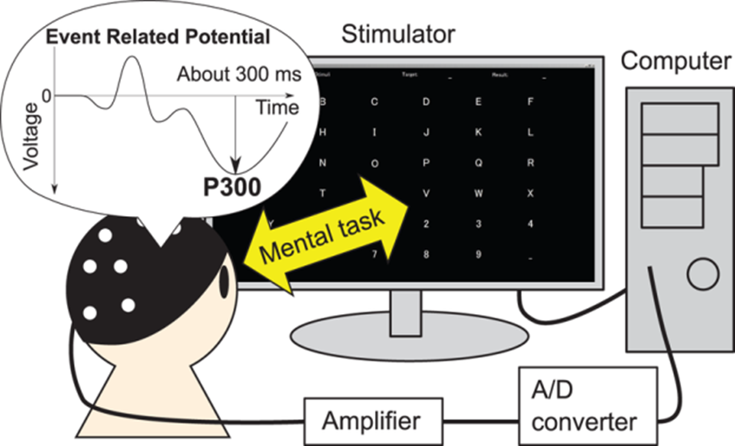
The P300 wave is an event-related brain potential measured using electroencephalography (EEG). P300 refers to a spike in activity approximately 300ms following presentation of the target stimulus.

Slide 9
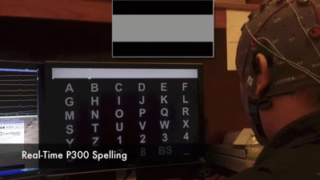

Slide 10
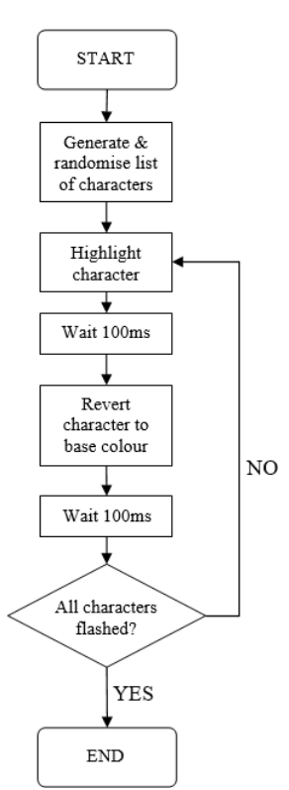
P300 SPELLER USING WEB DEVELOPMENT LANGUAGES
HTML
CSS
JAVASCRIPT
There are some elements of the P300 Speller that do not vary with time. These time-static elements such as background colour and button positions can be realized using HTML and CSS. However, ithe P300 Speller also has time-dynamic elements such as element colour changes and timing delays. The only client-side language capable of expressing time-dynamic behaviour is JS. This work also uses JQuery which is a JS Library capable of shorthand coding conventions.

Slide 11
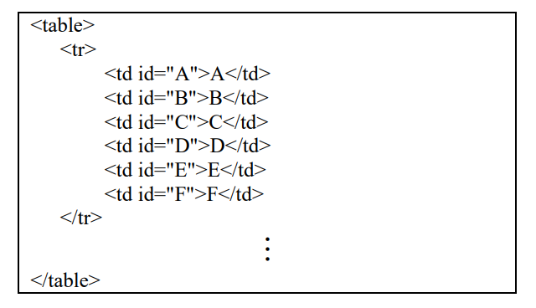
HTML
The matrix of P300 Speller elements was realised as a table in HTML. This is the HTML code for the first row of Speller element .The remaining 5 rows denoted by the vertical ellipsis are identical to tow 1 besides the text and HTML ids.

Slide 12
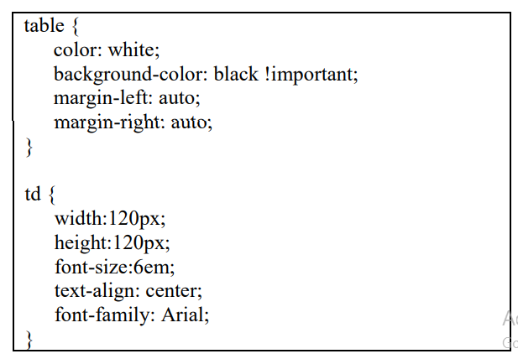
CSS
Each element of the P300 Speller matrix was given a unique id label in HTML. This was done to enable easy targeting by the CSS for character flashing. The CSS code snippet that defines the margins and background-foreground colour for the P300 elements is shown.

Slide 13
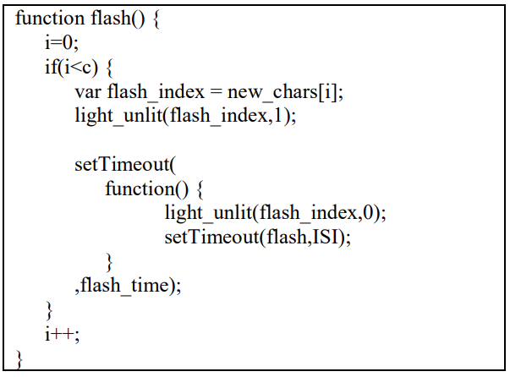
JAVASCRIPT
The JS code snippet is responsible for the time dynamic aspects of the P300 Speller Paradigm.
The ‘new_chars’ variable with length ‘c’ is defined outside of the function and contains the total list of characters to be flashed based on the number of trials. The “light_unlit” function flashes a P300 matrix element if the second function input is ‘1’ and reverts the element base colour to white if the second input is ‘0’. The “setTimeout” function waits for a certain time before running some specified code. Recursion is then employed to ensure that the code progresses to highlight and then revert character colours until the total character set is flashed.

Slide 14
Thank You!

